Slide 1
Suburban Lancaster Sewer Authority
1800 and 1900 Blocks of Willow Street Pike Sewer Line Replacement
September 30th, 2021

Slide 2
SLSA Officials Present
SLSA Board Members
Jim Witman, Chairman
Randy Moyer, Secretary
SLSA Engineer : CDM Smith, Inc
Tom Donahue, Project Manager
Byrne Remphrey, Senior Project Engineer
SLSA Solicitor : Blakinger Thomas, P.C.
Frank Mincarelli, Attorney

Slide 3
Purpose of Meeting
SLSA officials will discuss the following agenda items at this meeting:
Project purpose and scope
Extent of the project
Tentative project timeline
Pipe replacement construction method selected
Expected temporary construction disturbance and temporary disruptions of sewer service
Establishment of sewer easements
Future meetings and project updates
Questions from SLSA customers
Suburban Lancaster Sewer Authority

Slide 4
Purpose of Project
The existing sewer pipes were installed over 50 years ago and have deteriorated including root intrusion at joints, cracks, holes, sagging, etc.
The sewer pipes need to be replaced with modern, more durable and watertight pipe materials.
Sewer manholes will be rehabilitated or replaced.
Figure 1: Typical failure of old terra cotta pipe.
Suburban Lancaster Sewer Authority

Slide 5
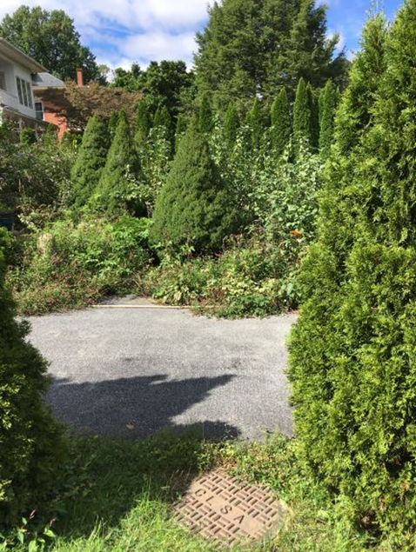
Background
Sewer pipes were originally constructed in the 1970’s.
Pre-dates Authority formation.
Pipe material: vitrified clay/ terra cotta.
Total pipe length 2430 LF.
Extends through the back of customers’ lots.
Figure 1: The backyard between 1943 and 1947 Willow Street Pike facing downstream direction.
Figure 2: The backyard between 1943 and 1947 Willow Street Pike.

Slide 6
Alignment of Existing Sewer Main

Slide 7
Tentative Project Timeline
Planning: September 2021 (current phase of project)
Engineering Design and Permitting: November 2021
Bidding for Construction: May 2022
Construction: July 2022
Completion: October 2022
Suburban Lancaster Sewer Authority

Slide 8
Traditional Trench Excavation vs Trenchless Methods
Traditional sewer excavation involves digging a trench down to the sewer lines for the entire length of the lines.
Traditional sewer excavations:
Require long construction time.
Cause significant impacts to existing landscapes and structures.
SLSA plans to use a trenchless method called Pipe Bursting, which requires some limited excavation areas, instead of continuous trenching, and results in less impact to homeowners’ landscapes and structures.
Pipe bursting was selected based on an evaluation of alternatives by SLSA’s engineer.

Slide 9
Traditional Trench Excavation vs Trenchless Methods
Traditional Trench Excavation
Trenchless Excavation
Suburban Lancaster Sewer Authority

Slide 10
Alignment of Proposed Sewer Main
Note: Launching and receiving pits are not drawn to scale
Proposed Manhole

Slide 11
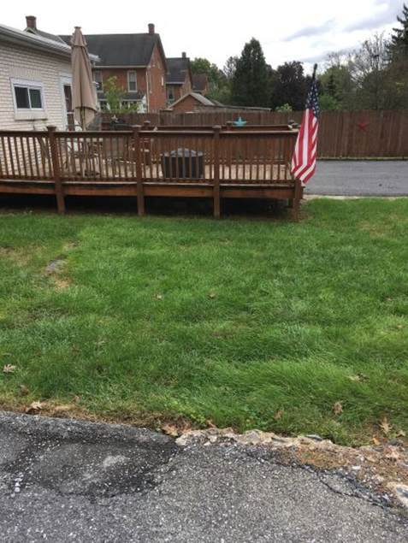
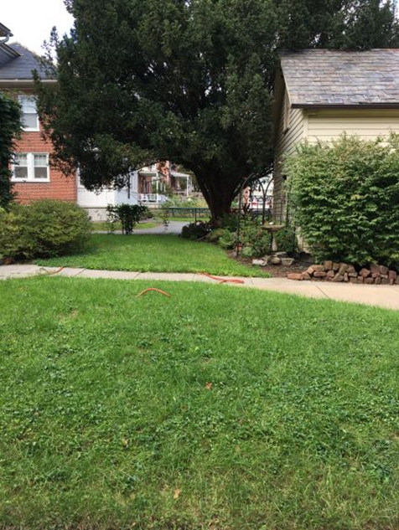
What does this mean to homeowners
SLSA is performing this pipe replacement work at no cost to the homeowners.
Small excavations will need to be made to reconnect the service line at each property.
Larger excavations will need to be made at specific locations in order to facilitate the pipe bursting.
Temporary (typically 1 day) loss of sewer service will occur at times during the project while transitioning from the old pipe to the new pipe.
SLSA’s contractor will provide portable toilets and wash stations for residents’ use.
Figure 1: The backyard of 1914 with the sewer alignment passing underneath or near this deck and another structure to the right.
Figure 2: The backyard of 1905 Willow Street Pike on sewer alignment facing the upstream direction.
Notes:
SLSA will provide potable toilets and wash stations during construction.

Slide 12
Sanitary Sewer Easements
Documentation of formal sewer easements for the existing sanitary sewer lines does not exist.
Therefore, SLSA would like to establish formal sanitary sewer easements across the residential properties (along the alignment of the existing pipes).
Establishment of the sewer easements is necessary at the planning stage.
SLSA’s solicitor has prepared sewer easement agreements that are available for review and signing at this meeting.

Slide 13
Future Meetings and Project Updates
Subsequent meetings with residents are anticipated as project proceeds to engineering design then construction.
SLSA will add a webpage on its website (sublancsewer.com) for the project that will include project updates and responses to FAQ’s.
Suburban Lancaster Sewer Authority

Slide 14
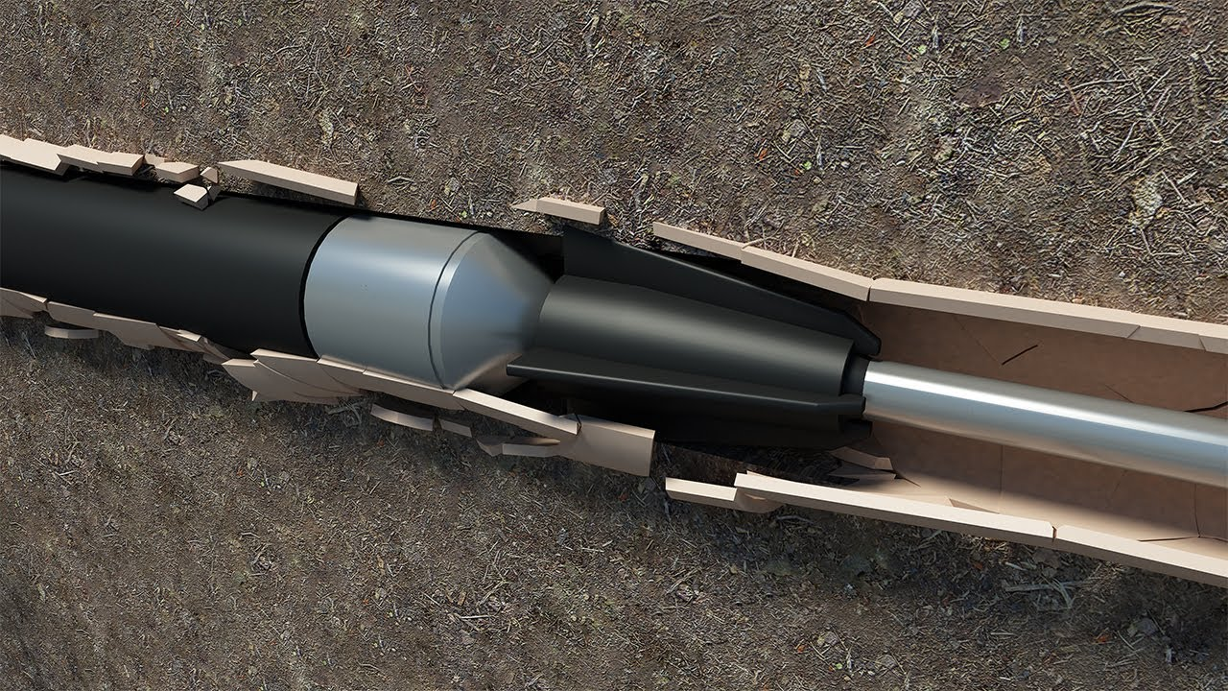
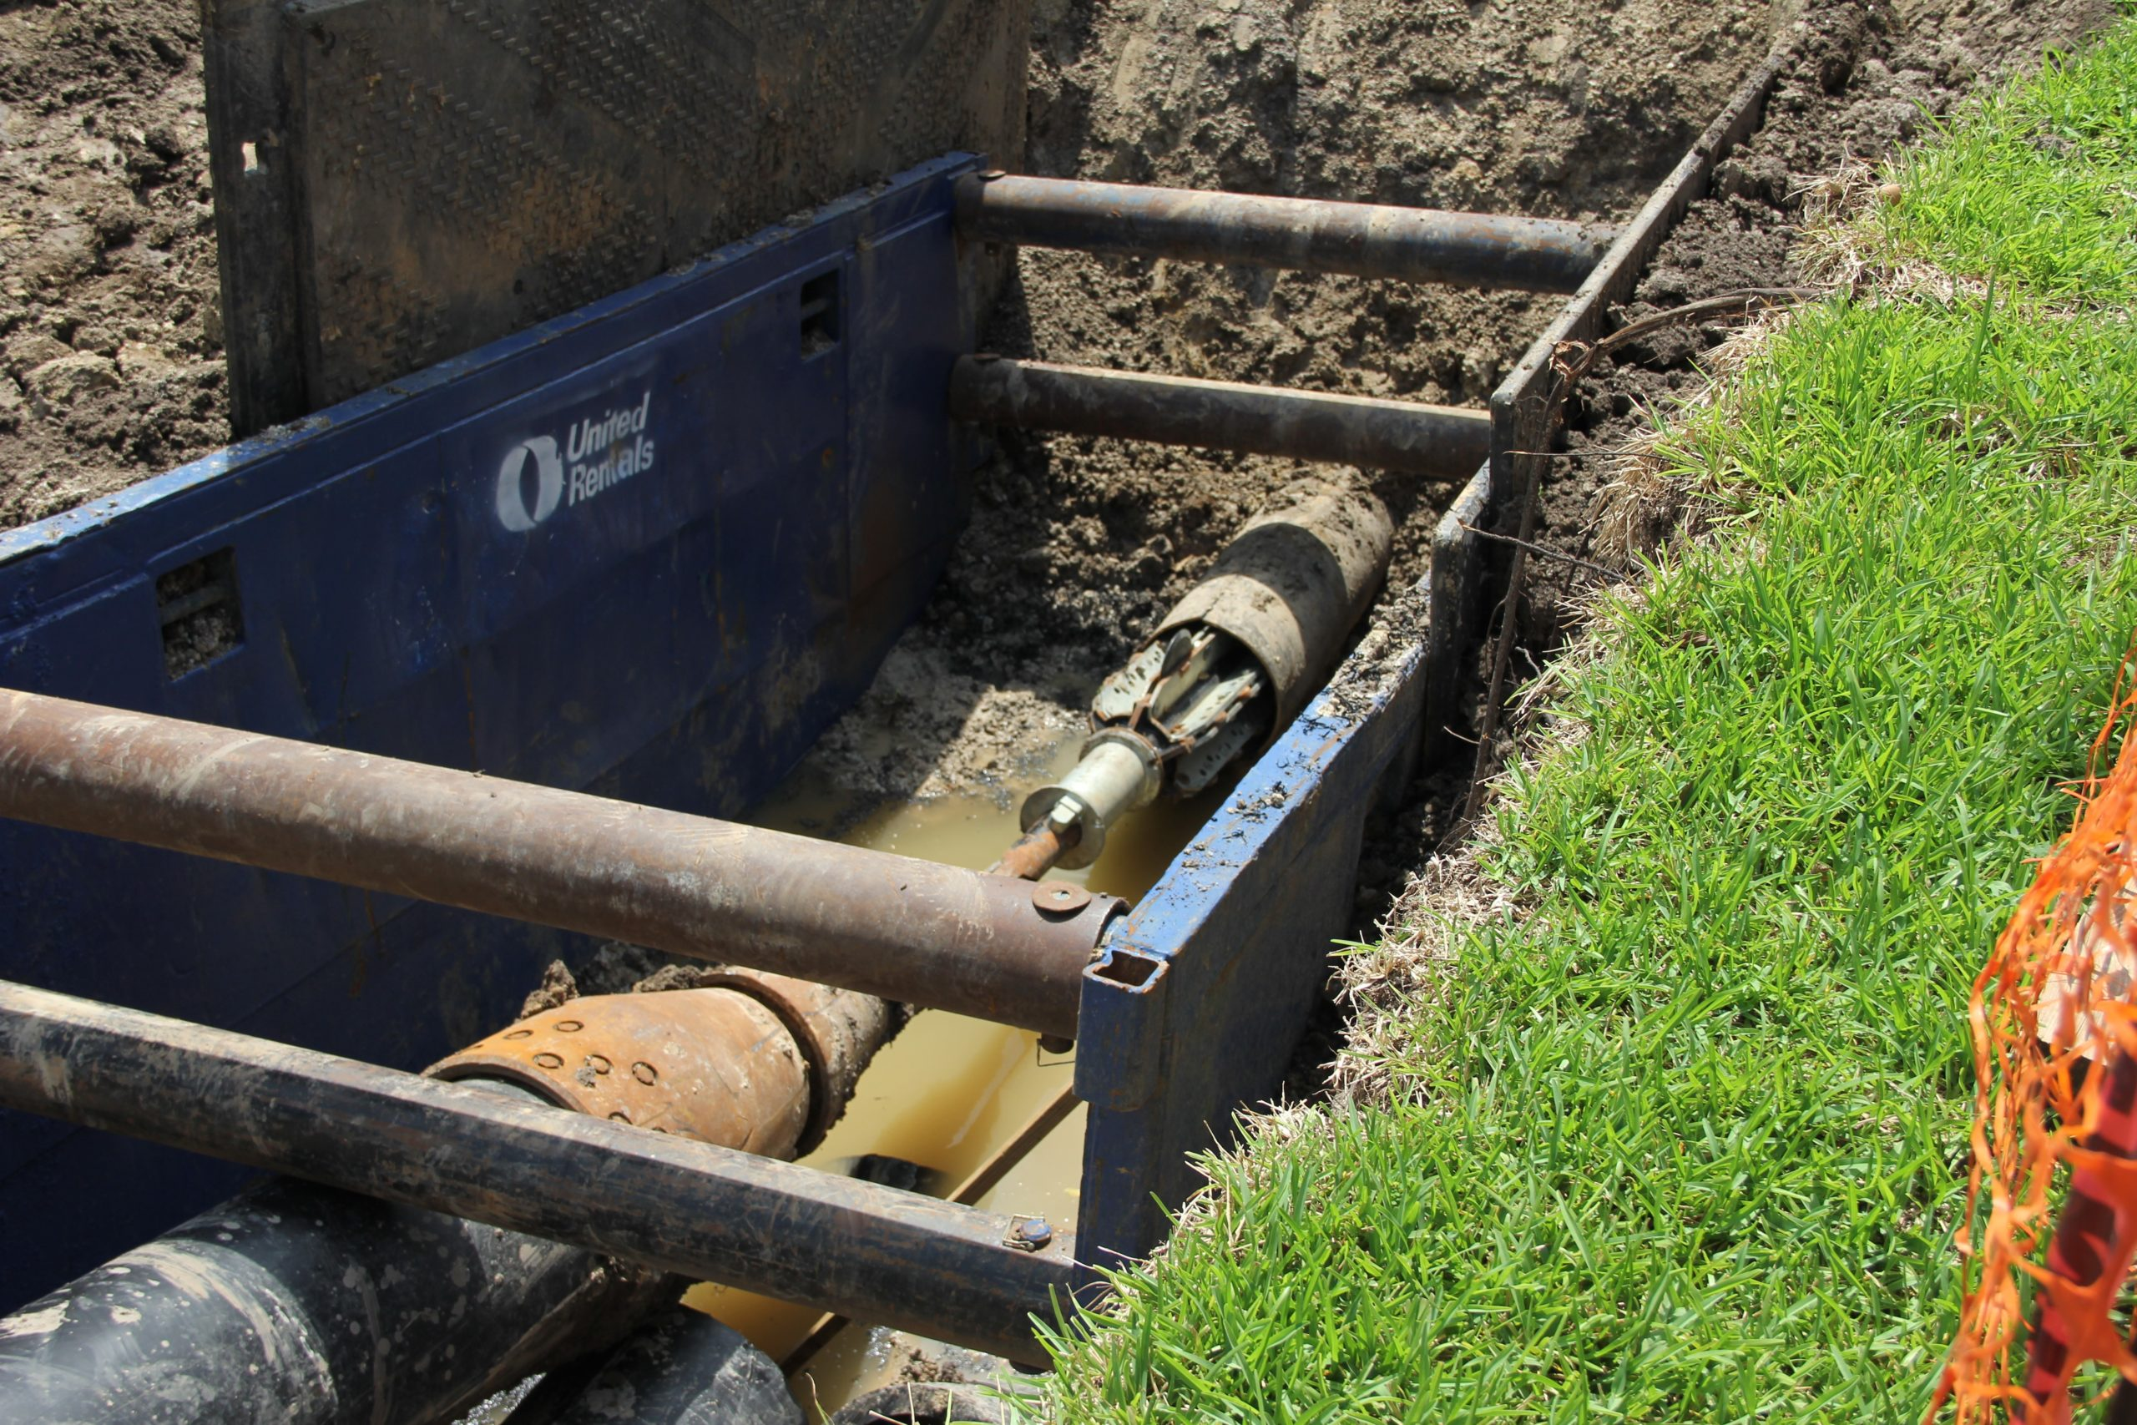
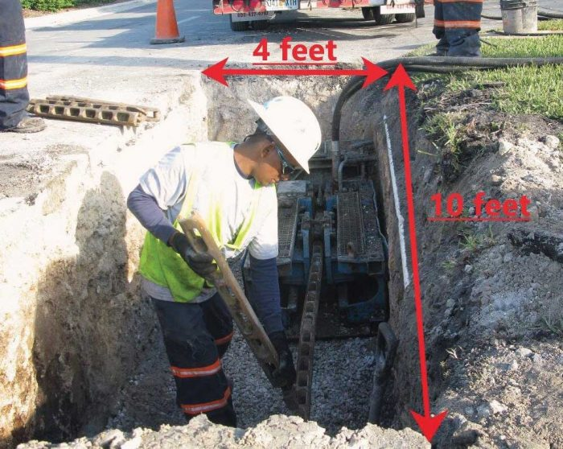
Questions ?

